Slide 1
Building an Ai

Slide 2
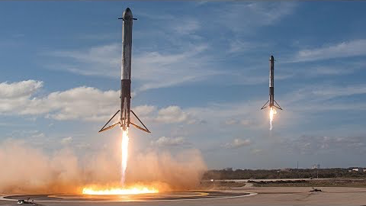

Slide 3
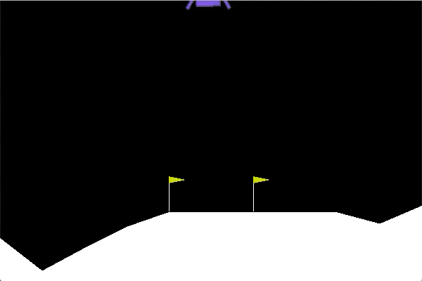
Lunar Lander 2D Simulation Environment
Objective: Gently land the lander between the flags using the least fuel possible.

Slide 4
The Plan
Introducing the OpenAI Gym
Program inside “Jupyter Notebooks”
Program the lander for fun
Program an AI to control the lander
Review the results
Oh and… everyone codes!

Slide 5
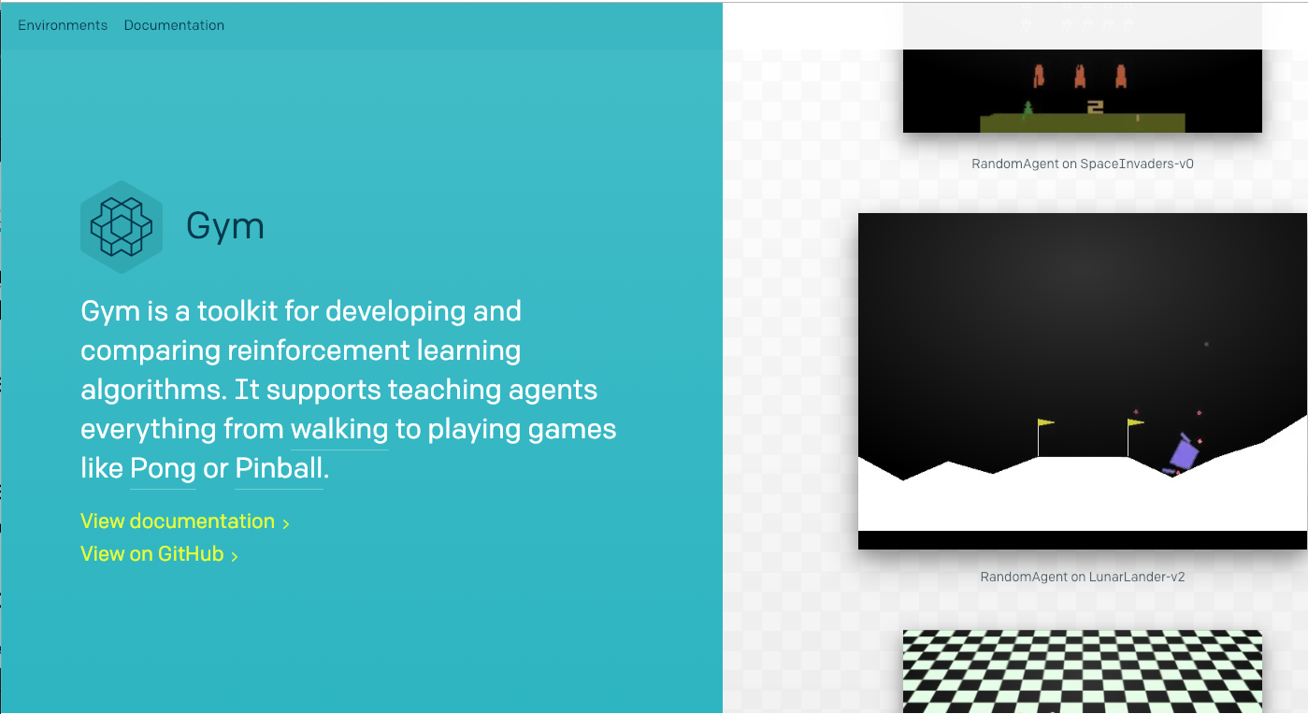
OpenAI Gym
OpenAI is company founded by Elon Musk and others.
Their mission is to ensure “AI benefits all of humanity”
They do research and share tools to help people learn to build and understand the implications of AI.
Open AI Gym is one of these tools

Slide 6
OpenAI Gym
Open Google Chrome web browser and go to this address
https://gymclass.gamebridge.ai:8000/
Login using surname of any astronaut that landed on the moon.
Password is sesame8
The Gym is a programming library. We have to program to make it work. Libraries make it easy to create new things as we build on other people’s work!
We will be programming in a language called Python. This is perhaps the most popular language for programming AIs today.
We will use a tool called Jupyter Notebooks to write out code and make it easy
Notes:
Teacher login (enter without inverted commas)
Username “teacher”
Password “sesame124”
Usernames
aldrin bean cernan gymadmin mitchell schmitt shephard
armstrong bob conrad irwin robin scott teacher

Slide 7
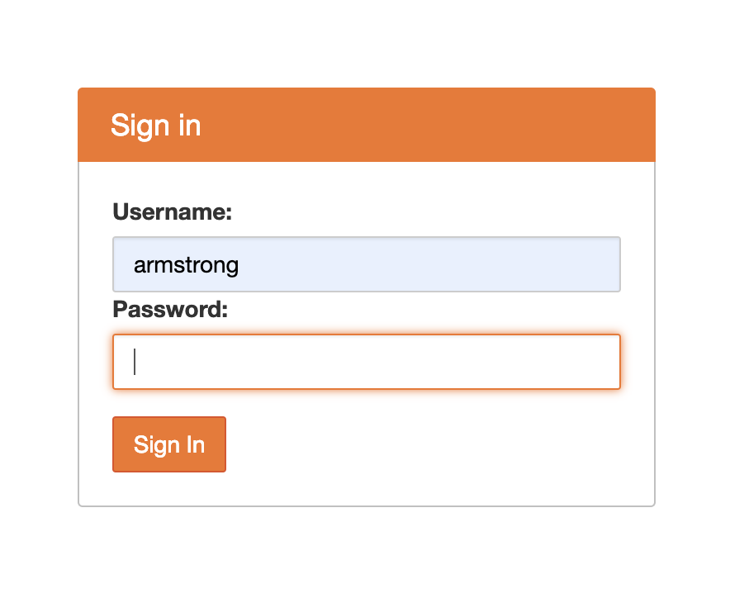
10 Astronauts who walked on the moon.
Username / Password
Username / Password
armstrong / sesame8
aldrin / sesame8
conrad / sesame8
bean / sesame8
shephard / sesame8
young / sesame8
mitchell / sesame8
scott / sesame8
irwin / sesame8
cernan / sesame8
schmitt / sesame8
duke / sesame8

Slide 8
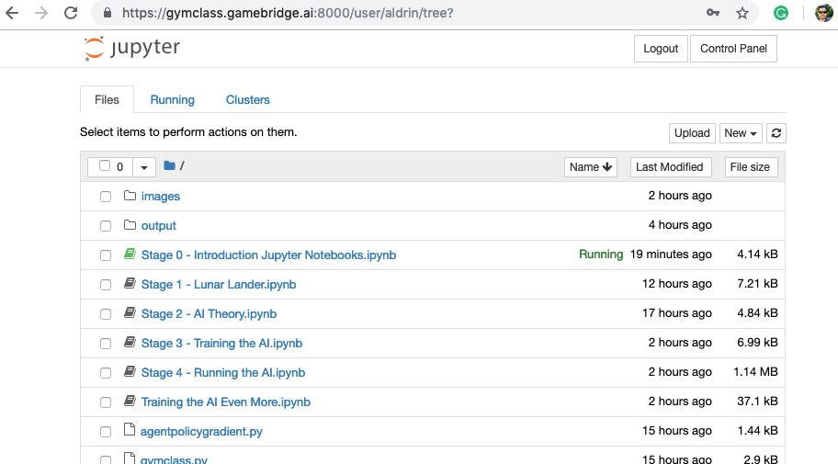
Lets Open a Notebook
CLICK HERE!

Slide 9
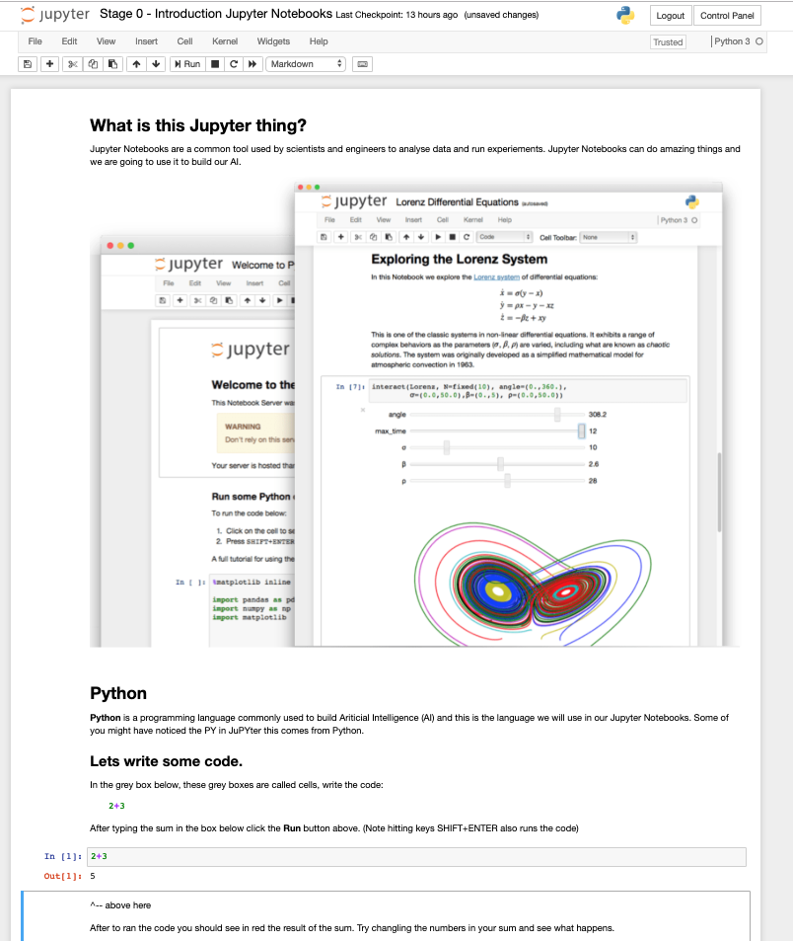
Jupyter Notebooks
Jupyter Notebooks are a common tool used by scientists and engineers to analyse data and run experiments. Jupyter Notebooks can do amazing things and we are going to use it to build our AI.

Slide 10
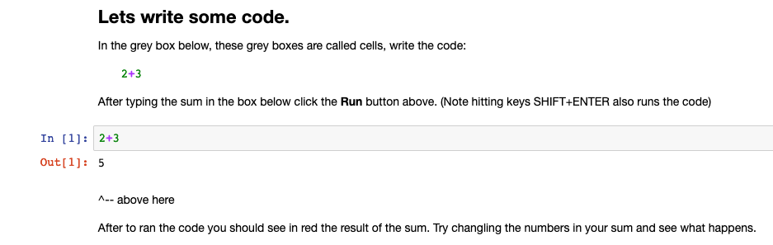
Lets do a simple sum in the workbook
Code Cell

Slide 11
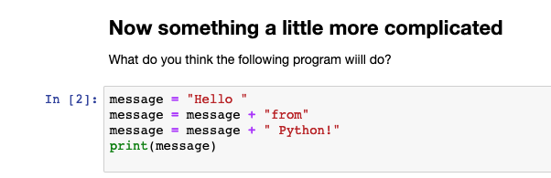
Coding something simple
Here we are adding strings together and not numbers
Notes:
Run the program to see the answer. “Hello from Python!”

Slide 12
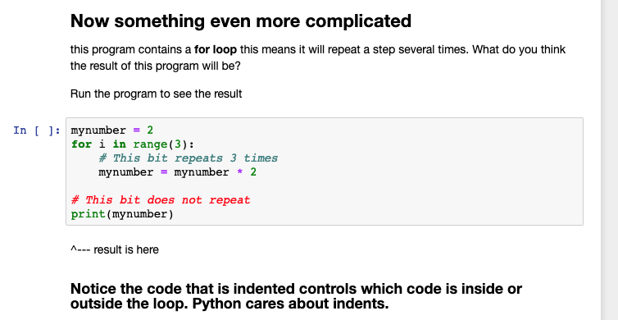
We are going to code a For-Loop
Notes:
Talk through this program:
Mynumber starts as 2
The loop will repeat 3 times and each time it will multiple mynumber by 2
2 x 2 = 4
4 x 2 = 8
8 x 2 = 16
Answer 16!

Slide 13
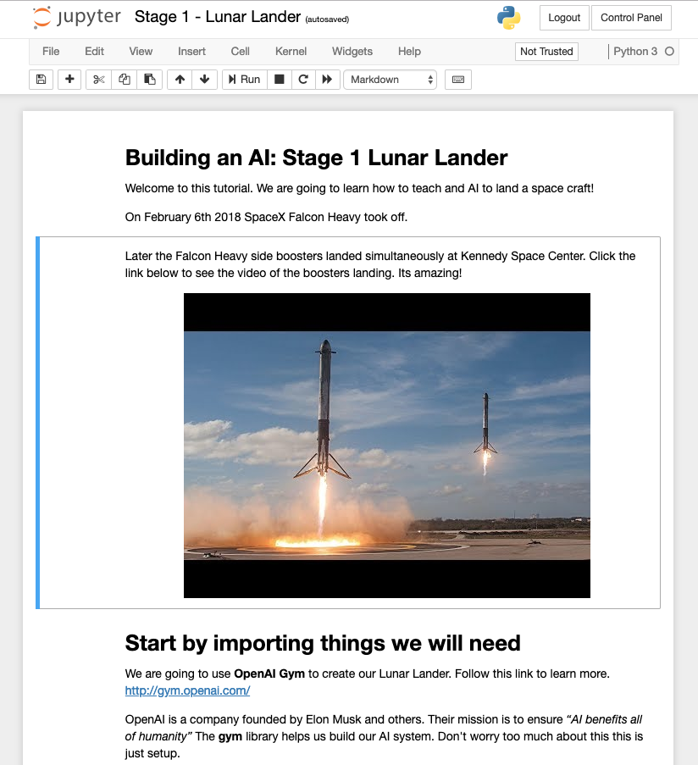
Go to the next Notebook
CLICK HERE!
Click here to watch the video of Falcon Heavy boosters landing!

Slide 14
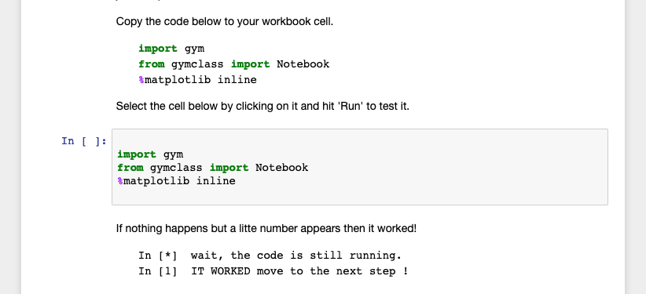
Lets get started with the OpenAI Gym
COPY CODE INTO THIS CELL AND RUN
We are now ready to start using the OpenAI Gym

Slide 15

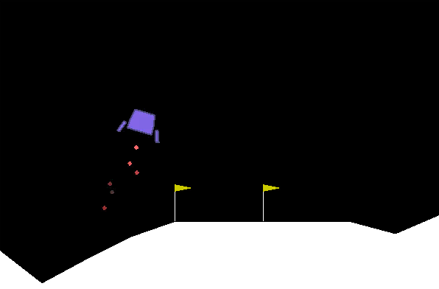
OpenAI Gym: A little theory
?
Environment
Observation
Action
Agent
?

Slide 16
OpenAI Gym: A little theory
Position (X,Y), Velocity, Angle,
Angular Velocity
Environment
Observation
Action
Agent
Do Nothing =0,
Left Thruster =1, Main Thruster =2,
Right Thruster =3

Slide 17
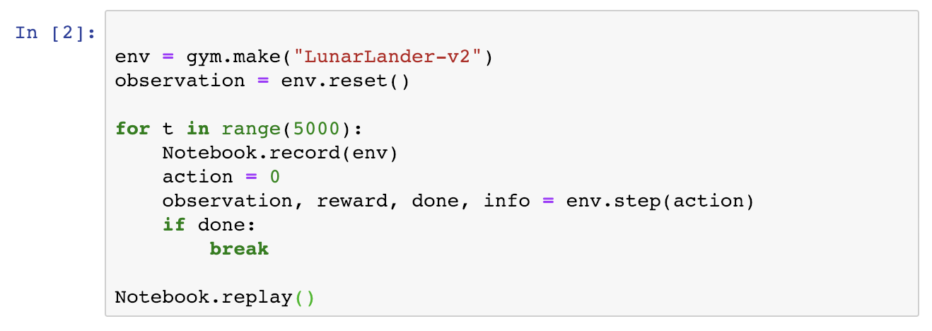
Jupyter Notebooks
Make the gym environment
What is happening here
Reset to start position
Loop for 5000 times
Perform Action (0 = Nothing)
Our Agent does nothing!
Play the recorded actions to see what happened!

Slide 18
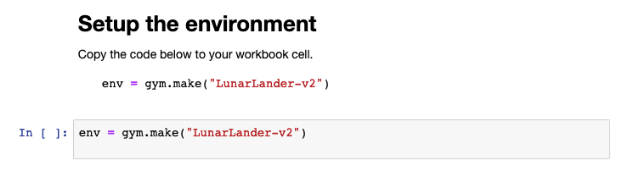
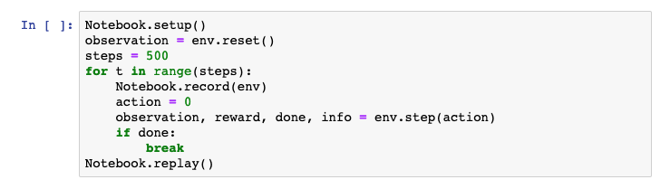
In your Notebook you should see
RUN THIS CELL
RUN THIS CELL
What do you see?

Slide 19
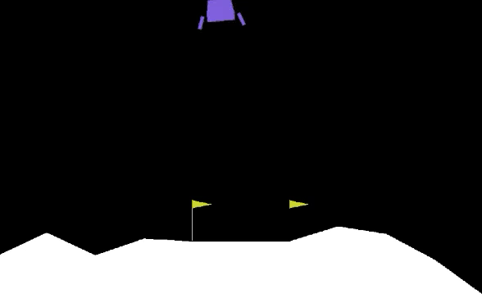
Slowly crashing!

Slide 20
Lets change it for fun!!!
Do Nothing =0,
Left Thruster =1, Main Thruster =2,
Right Thruster =3
You should be looking at
Change this zero to 1, 2 or 3
Run again!
1
3
Lander
2

Slide 21
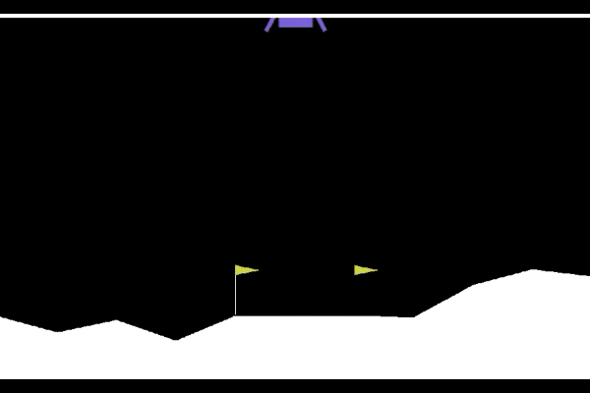
Crashing differently!!!

Slide 22

Stage 2: Quick Theory of Neural Networks
CLICK HERE!

Slide 23
OpenAI Gym: What does our Agent need to do?
Position (X,Y), Velocity, Angle,
Angular Velocity
Environment
Observation
?
Action
Agent
Do Nothing =0,
Left Thruster =1, Main Thruster =2,
Right Thruster =3

Slide 24
Agents need to decide actions based on observations
Position (X,Y), Velocity, Angle,
Angular Velocity
Do Nothing =0,
Left Thruster =1, Main Thruster =2,
Right Thruster =3
?
Observation
Action
Agent
Observations
are numbers
Actions
are numbers

Slide 25
A Neural Network Agent
Neural Network
Observation
Position X
Do Nothing
Action
Position Y
Left Thruster
Velocity
Main Thruster
Angle
Right Thruster
Angular V
Observations
are numbers
Actions
are numbers
Agent

Slide 26
Signals Propagate From Observations Forward To Create Actions
FORWARD
Signals propagate based on the network weights (numbers) which it learns!
Observation
Position X
Do Nothing
Action
Position Y
Left Thruster
Velocity
Main Thruster
Angle
Right Thruster
Angular V
Observations
are numbers
Actions
are numbers
Agent

Slide 27
How does the network learn?
1) Signals propagate forward through the network based on the trained network weights (numbers). The weights transfer activation from on node to the next in a forward direction.
FORWARD
Hidden Node
Input Node
Output Node
Observation
Position X
Do Nothing
Action
Position Y
Left Thruster
Velocity
Main Thruster
Angle
Right Thruster
Angular V
Observations
are numbers
Actions
are numbers
Agent

Slide 28
How does the network learn?
2) Current output is wrong we need ‘Left Thruster’ not ‘Main Thruster’ to be on, we need to adjust
FORWARD
Hidden Node
Input Node
Output Node
Observation
Position X
Do Nothing
Action
Position Y
Left Thruster
Velocity
Main Thruster
Angle
Right Thruster
Angular V
Observations
are numbers
Actions
are numbers
Agent

Slide 29
3) We adjust the weights (numbers) backwards through the network so that ‘Left Thruster’ is on. We adjust all weights at once but we do it a little at a time over many examples. So the agent learns from many different circumstances
How does the network learn?
FORWARD
Hidden Node
Input Node
Output Node
Observation
Position X
Do Nothing
Action
Position Y
Left Thruster
Velocity
Main Thruster
Angle
Right Thruster
Angular V
Observations
are numbers
Actions
are numbers
Agent
It can take a long time to it just right!

Slide 30
There are 4 Output Nodes. Does means the agent can do 4 things at once?
FORWARD
Hidden Node
Input Node
Output Node
Observation
Position X
Do Nothing
Action
Position Y
Left Thruster
Velocity
Main Thruster
Angle
Right Thruster
Angular V
Observations
are numbers
Actions
are numbers
Agent
It can take a long time to it just right!

Slide 31
In theory yes… but not in this case!
The Lunar Lander Environment only allows 1 of 4 actions at a time
Output Nodes
These numbers are probabilities. Its how certain the agent is that this is the right action!
Do Nothing
0.1
Left Thruster
0.7
Main Thruster
0.2
Right Thruster
0.3
1.0 = Totally positive this action is RIGHT
0.5 = Coin toss, half the time this is right
0.0 = Totally positive this action is WRONG
Actions
are numbers

Slide 32
We convert the 4 probabilities into a single action number
The Lunar Lander Environment only allows 1 of 4 actions at a time
Output Nodes
Do Nothing
0 = Do Nothing
1 = Left Thruster 2 = Main Thruster
3 = Right Thruster
0.1
Left Thruster
0.7
Main Thruster
0.2
Right Thruster
0.3
Actions
are numbers

Slide 33
Lets Train an AI Agent! Stage 3
CLICK HERE!

Slide 34
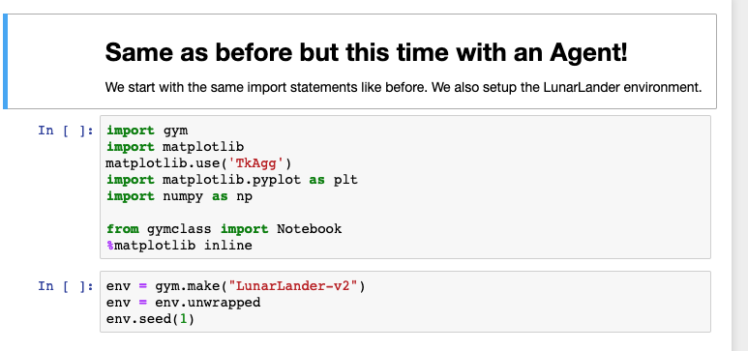
Run these code cells to setup your environment
RUN THIS CELL
RUN THIS CELL

Slide 35
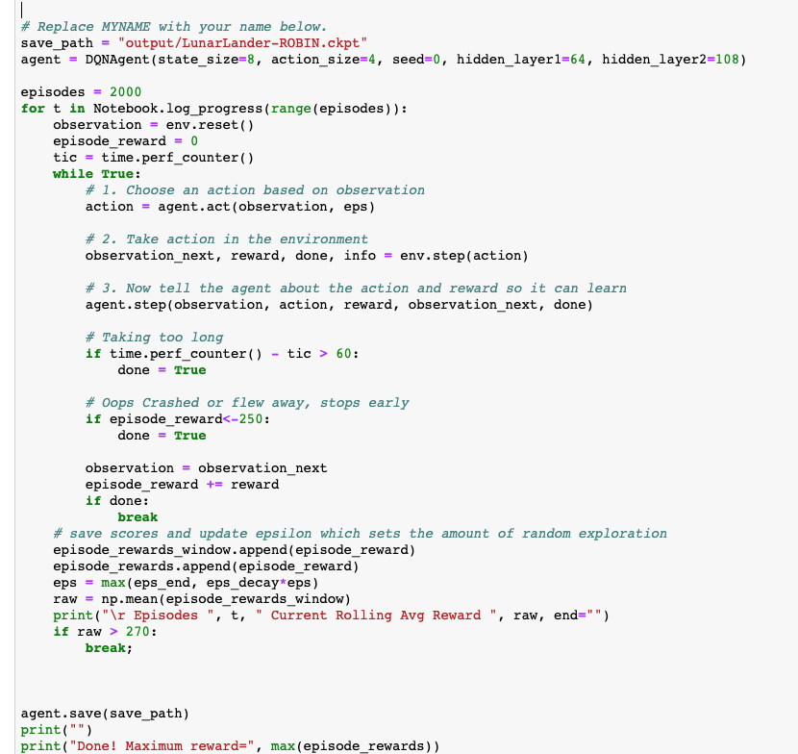
We have 2 loops here
This outer loop is landing attempts, we call them episodes. It is like one life in a video game. We reset the environment at the start of each episode
This inner loop runs the episode or game until we say its done

Slide 36
Inner loop plays the game
Inside each Episode
Agent chooses an action
We advance the environment 1 step
We record the action and reward
We stop the episode if its taking too long or if the lander crashes
Episode is over, update the recorded scores.

Slide 37
Get ready to train an AI

Slide 38
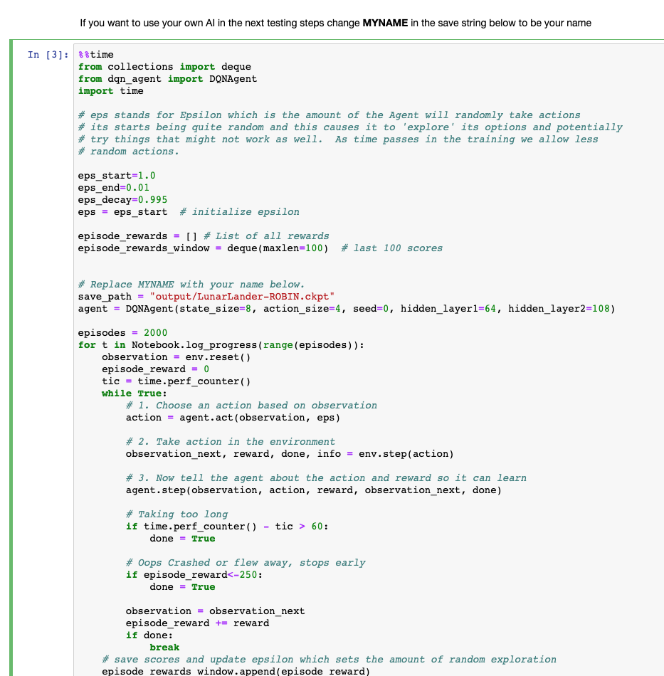
Run this cell… its going to take a while! (17 minutes)
Put your name here this will be your Agent!
RUN THIS CELL
Scroll down to see it working

Slide 39
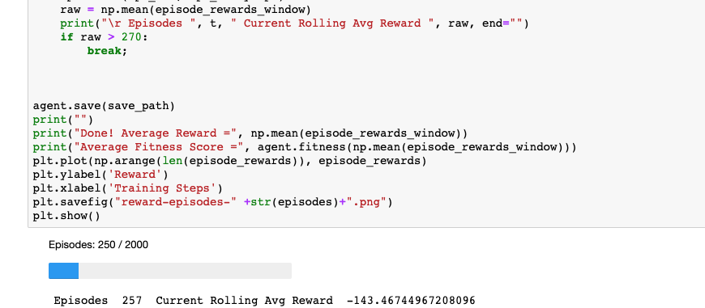
First you are going to see it learning
Each count here is a single episode or run of the game. It runs really fast because we are not watching the environment so it can run at high speed!
You should see this reward score improve over time

Slide 40
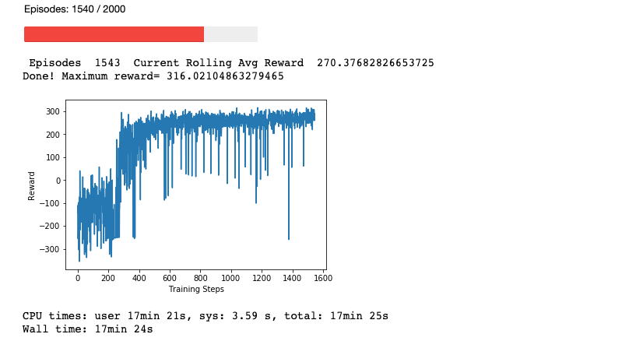
When its done it will draw a graph
As you see little by little the Agent is getting better at the game as the reward (its score in the game) is getting better.
This is Machine Learning!
After about 500 episodes the agent is pretty good.
Sometimes bad things happen even after long training. This is usually by chance the agent can not cope with the environment either the start position or the moon terrane.
Notes:
Discuss with the class why everyone is getting a different best score. Why are the scores different each time? The agent learns form experience and the experience is different each time it plays. Like in the real world this environment changes a little each time. So the agents learn themselves from their unique experiences. Some have experiences which cause them to learn new tricks. Sometimes they are also lucky they get a good score because they by chance make the right choices. The longer we train the AI the more similar their scores will become. We have not trained for long enough. Also sometimes an agent takes WAY LONGER to train. Can you think why? This is because the Agents learn to hover… we will see this soon. Once an Agent learns to hover they can take much longer to complete the game!

Slide 41
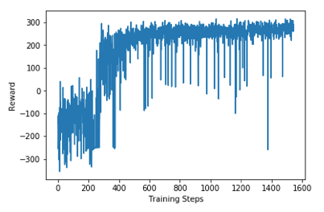
How ‘Reward’ score relates to ‘Fitness’
For the experiment we want a percent score which is between 0% and 100%
Reward 100 or less is a bad crash
Reward 200 is considered passing mark
Reward 300 is considered a perfect score
0% = Bad Crash
50% = Passing Score, landed
100% = Excellent Landing
Fitness
100%
50%
0%
Notes:
Discuss with the class why everyone is getting a different best score. Why are the scores different each time? The agent learns form experience and the experience is different each time it plays. Like in the real world this environment changes a little each time. So the agents learn themselves from their unique experiences. Some have experiences which cause them to learn new tricks. Sometimes they are also lucky they get a good score because they by chance make the right choices. The longer we train the AI the more similar their scores will become. We have not trained for long enough. Also sometimes an agent takes WAY LONGER to train. Can you think why? This is because the Agents learn to hover… we will see this soon. Once an Agent learns to hover they can take much longer to complete the game!

Slide 42
Lets see the result!
CLICK HERE!

Slide 43
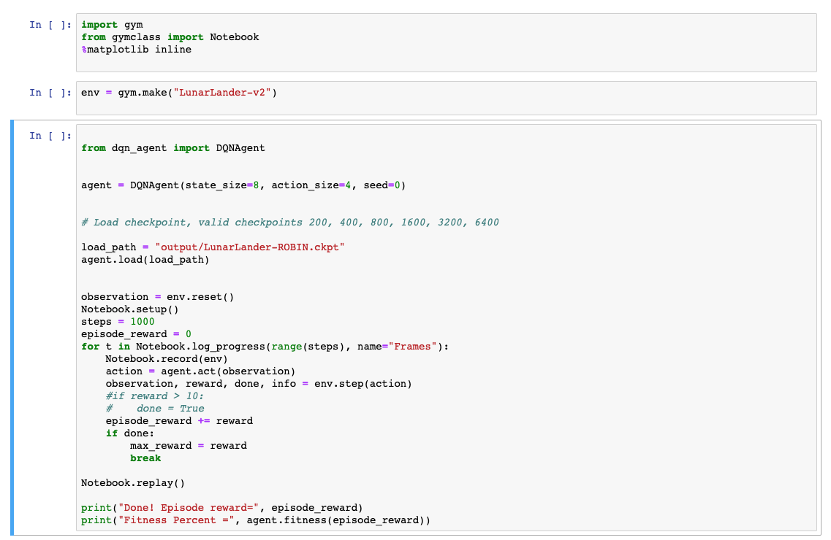
Try running your Agent!
RUN THIS CELL
RUN THIS CELL
Change here to your NAME or different values to see different Agents trained for different parameters
RUN THIS CELL
Scroll down to see a movie of the agent (be patient)

Slide 44
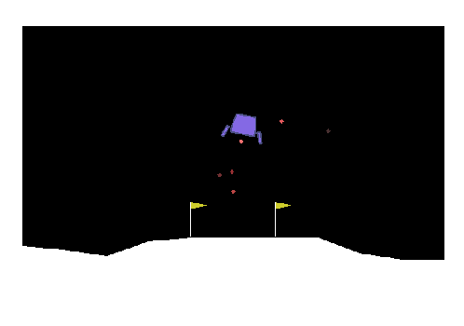
You just built an AI !!!
Good job!

Slide 45
What did we learn?
How to work in Jupyter Notebooks
How to create a Lunar Lander environment in OpenAI Gym
What Environment and Agents are in Machine Learning
How Neural Networks work
How to train our own AI
How training time and experience is important to the result.

Slide 46
Thank you!

